Slide 1



x
Introduction to hidden Markov modelling for acoustic telemetry
Kim Whoriskey, Dalhousie University
kwhoriskey@dal.ca
@kimprobable42

Slide 2
Purpose

Slide 3

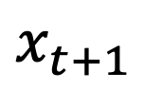

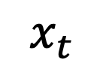
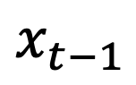

HMM basics
Movement
(observed) process
$$x_{t−1}$$
$$x_{t}$$
$$x_{t+1}$$
Behavioural
(hidden) process
$$b_{t−1}$$
$$b_{t}$$
$$b_{t+1}$$

Slide 4
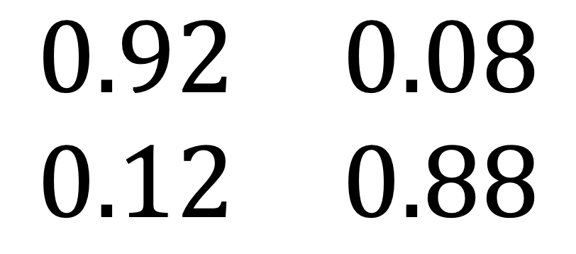
Behavioural Process
Markov Chain (t depends only on t-1)
Bernoulli (or categorical) trials
Governed by the TPM (transition probability matrix)
(
)
$$\begin{matrix}0.92 & 0.08 \\ 0.12 & 0.88\end{matrix}$$

Slide 5
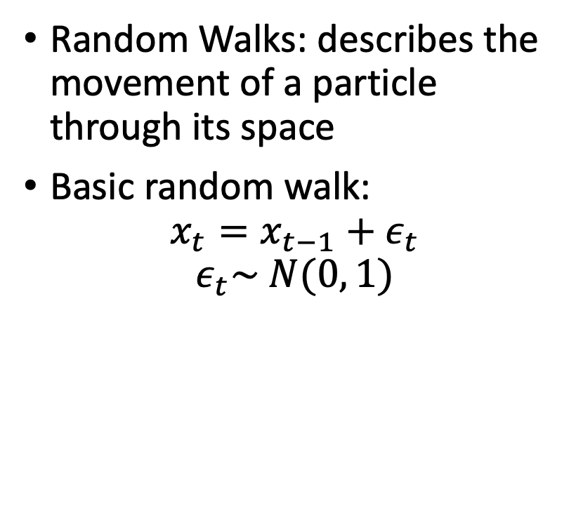
Movement Process
Random Walks: describes the movement of a particle through its space
Basic random walk:
$$x_{t}=x_{t−1}+ε_{t}$$
$$ε_{t}\sim N(0, 1)$$

Slide 6
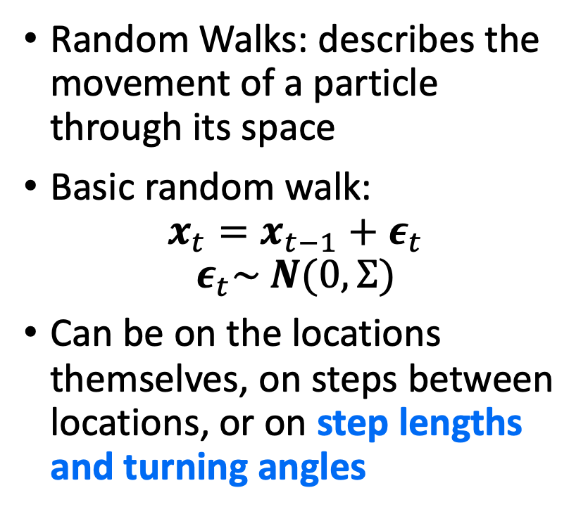
Movement Process
Random Walks: describes the movement of a particle through its space
Basic random walk:
$$x_{t}=x_{t−1}+ε_{t}$$
$$ε_{t}\sim N(0,Σ)$$
Can be on the locations themselves, on steps between locations, or on step lengths and turning angles

Slide 7
HMM Assumptions
Your location data must be highly accurate
in my experience some positioning data (e.g., VPS/Thelma pinpoint) can be v tricky to fit to, and YAPs can often do a better job of providing locations closer to the true track
They must also be continuous in space
And they must be discrete in time (for this tutorial)

Slide 8
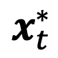
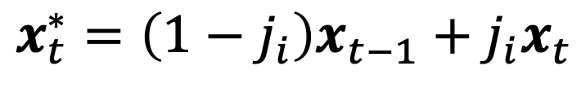
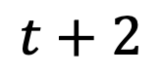
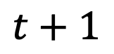
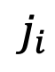
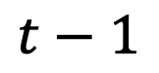
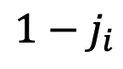
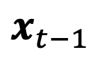
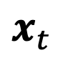
Step 1: Interpolate Track
$$x_{t}^{∗}=\left(1−j_{i}\right)x_{t−1}+j_{i}x_{t}$$
The HMMs we will be using work in discrete time, which means all observations have to occur over a regular time scale
Typically, we linearly interpolate the data – weighted average of the previous and next locations based on temporal differences.
This is an approximation to the real track, it introduces a subjective choice (time step), and we will see that it can lead to some autocorrelation
$$x_{t−1}$$
$$x_{t}^{∗}$$
$$x_{t}$$
$${1−j}_{i}$$
}
}
$$j_{i}$$
$$t−1$$
$$t+1$$
$$t+2$$
time
time corresponding to observed locations
time corresponding to interpolated locations

Slide 10
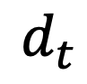
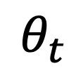
Step 2: Decompose track into step lengths and turning angles
Location
Turning angle
||
||
Step Length
$$d_{t}$$
$$θ_{t}$$

Slide 11
Step 3: Fit distributions to these (one for each state)

Slide 12
Step 4: Calculate behavioural states
Thank you Andrew Viterbi!
Observations
Hidden Behavioural States
Time

Slide 13
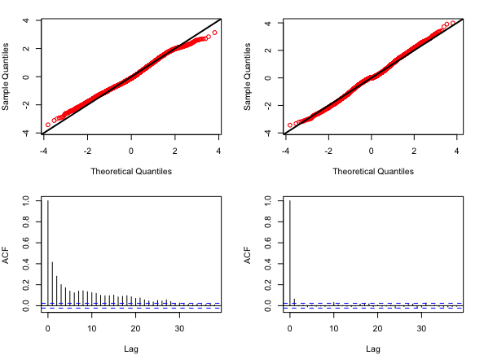
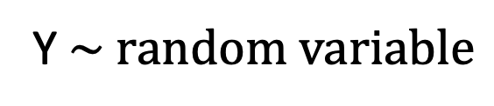
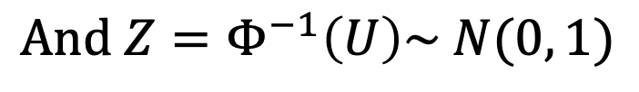
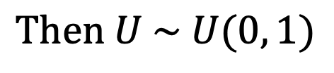
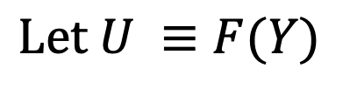
Step 5: Check residuals
One step ahead, or pseudo-
Based on the probability integral transform
Y$\sim random variable$
$$Let U ≡F(Y)$$
$$Then U \sim U(0, 1)$$
$$And Z=Φ^{−1}\left(U\right)\sim N(0, 1)$$
Figure from moveHMM pike example in code

